Slide 1
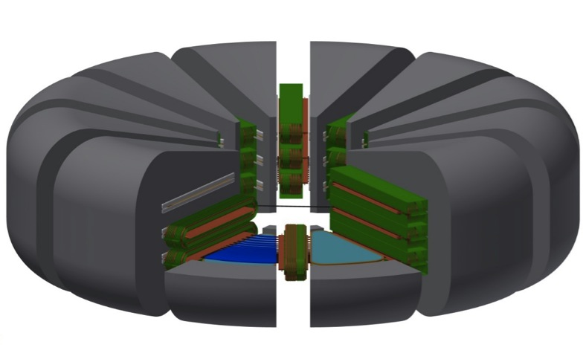

Strong-Focusing Cyclotron:
FFAG for High Current Applications
S. Assadi, J. Kellams, P. McIntyre,
K. Melconian, N. Pogue, and A. Sattarov
Texas A&M University
Notes:
Total 15 min, plan 12-13. Turn in day before talk

Slide 2
Outline
Motivation
  Proton driver for Accelerator-Driven Subcritical Fission
  What limits beam current in cyclotrons?
Superconducting RF Cavity
  Fully separate all orbits
  Distributed coupling to match beam loading
Beam Transport Channel
  Control betatron tunes throughout acceleration
  Magnetic design
  Winding prototype
Sector Dipoles
  Flux-coupled stack
  Fringe field reduction
Beam Dynamics

Slide 3
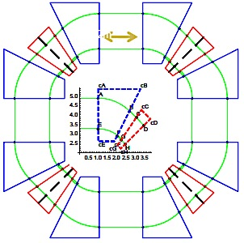
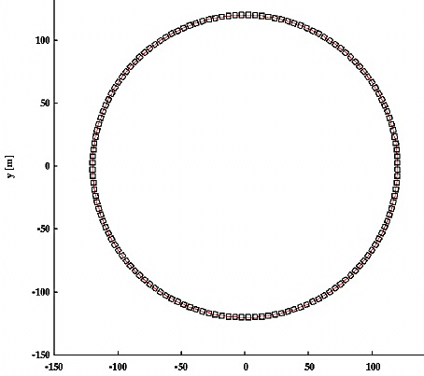
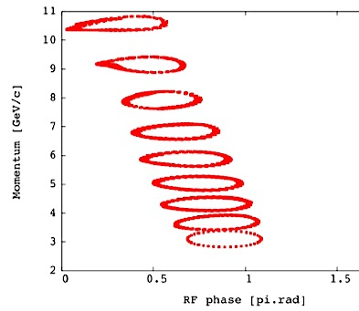
FFAG is typically configured to accelerate a large momentum admittance within a modest magnet aperture.
1 GeV CW FFAG for C Therapy
C. Johnstone – Trinity College, 2011
3 to 10 GeV muon double beam FFAG
T. Planche - Nufact09
They are brilliant designs, as long as you don’t want too much beam current…

Slide 4
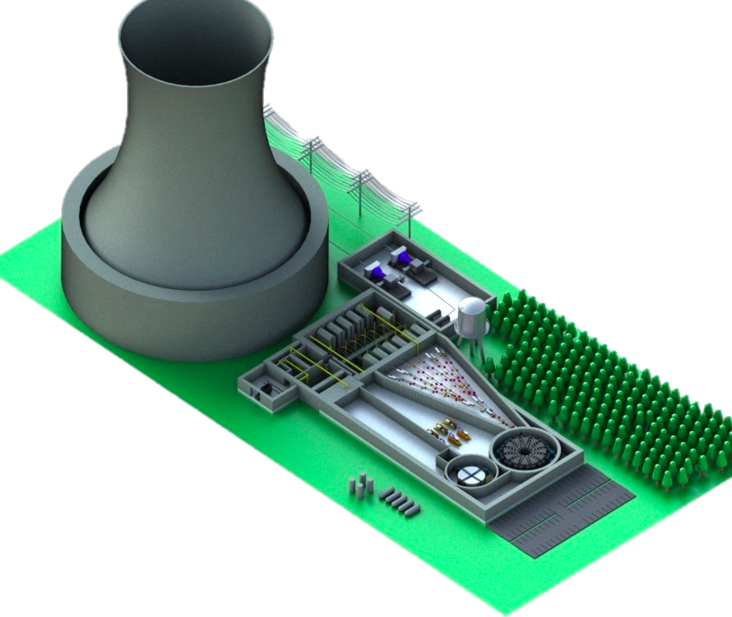
Accelerator Driven Molten Salt System
Destroy long lived nuclear waste
Close nuclear fuel cycle
Subcritical - Safe
Produce power
TAMU 800
TAMU 100

Slide 5
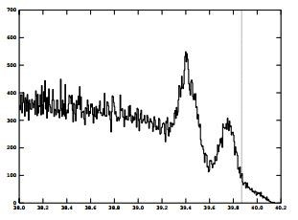
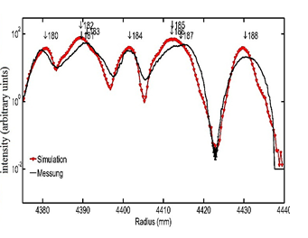
Current limits in cyclotrons:
1) Overlapping bunches in successive orbits
# particles
Radius (in)
http://www.nscl.msu.edu/~marti/publications/beamdynamics_ganil_98/beamdynamics_final.pdf
http://cas.web.cern.ch/cas/Bilbao-2011/Lectures/Seidel.pdf
Overlap of N bunches on successive orbits produces N x greater space charge tune shift,
non-linear effects at edges of overlap.

Slide 6
2) Weak focusing, Resonance crossing
Cyclotrons are intrinsically weak-focusing accelerators
Rely upon fringe fields
Low tune requires larger aperture
Tune evolves during acceleration
Crosses resonances
Scaling, Non-scaling FFAG utilize non-linear fields
Rich spectrum of unstable fixed pts
PSI
Space charge shifts, broadens resonances, feeds synchro-betatron
Even if a low-charge bunch accelerates smoothly, a high-charge bunch may undergo breakup even during rapid acceleration

Slide 7
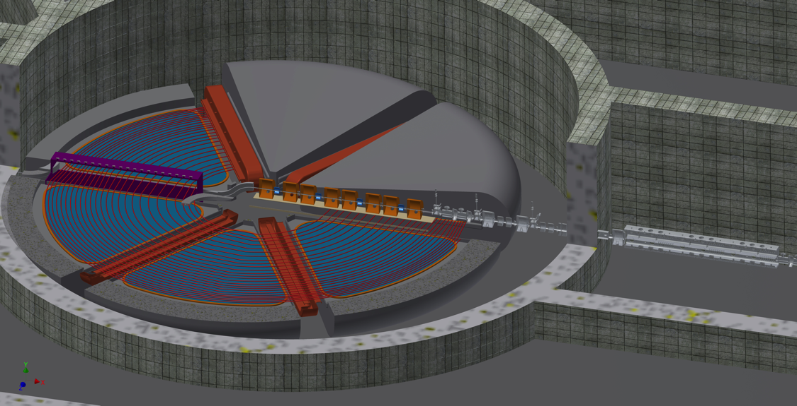
Strong-Focusing Cyclotron
Completely separate all orbits.
Put beam transport channels in each sector to control betatron tunes
Curing the limits of overlapping orbits and controlling tunes opens the high-current frontier:
Proton driver for ADS fission
Medical Isotope Production
Ion beam therapy
Muon Cooling

Slide 8

SFC Components
SRF Cavities
Warm Shielding Fins
Warm Flux Return
Beam Transport Channels
Cold-Iron Pole Piece
Sectors are simple radial wedges – optimum for integrating SRF

Slide 9
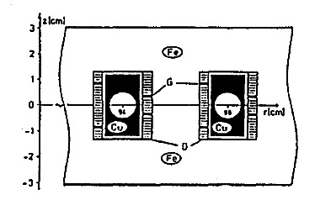
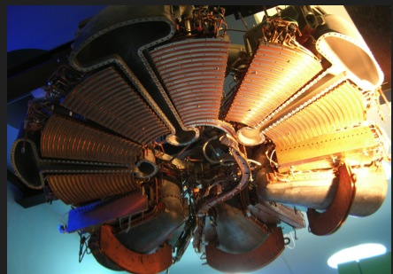
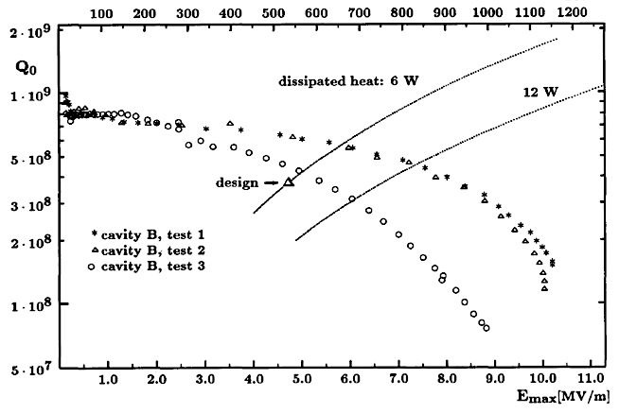
TRITRON was the first to attempt to make a separated orbit cyclotron
The good-field fraction of radial aperture was <50% for each orbit, so admittance was limited.
The intervening years of superferric magnet technology (and now MgB₂) and Nb cavity technology make this a fertile time to make a strong-focusing cyclotron for high current.
Energy gain in its superconducting Pb cavities was limited by multipacting.

Slide 10
Outline
Motivation
  Proton driver for Accelerator-Driven Subcritical Fission
  What limits beam current in cyclotrons
Superconducting RF Cavity Fully separate all orbits
Beam Transport Channel
  Control betatron tunes throughout acceleration
  Magnetic design
  Winding prototype
Sector Dipoles
  Flux-coupled stack
  Fringe field reduction
Beam Dynamics
Future Work

Slide 11

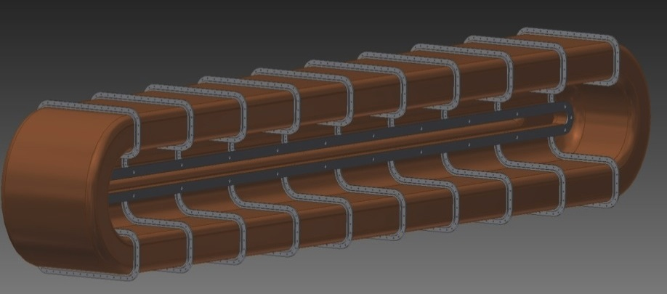
Slot-geometry ¼-wave SRF Cavities
Superconducting RF cavities
100 MHz
2 MV/cavity energy gain
20 MV/turn fully separates orbits

Slide 12
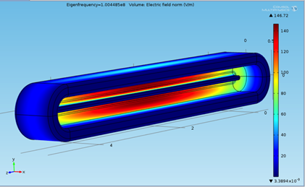
Example SRF Cavity Model
21 MV/m max surface electric field
54 mT max surface magnetic field
- less than design fields on SRF cavities for BNL, FRIB

Slide 13
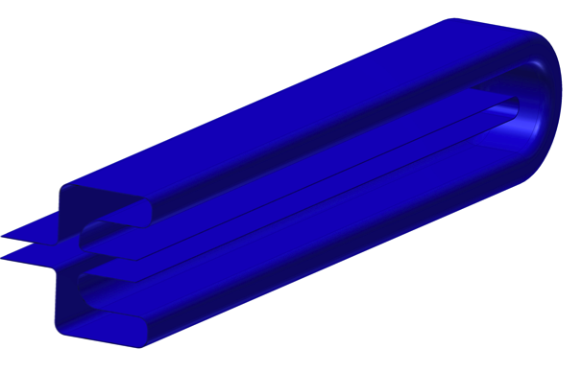
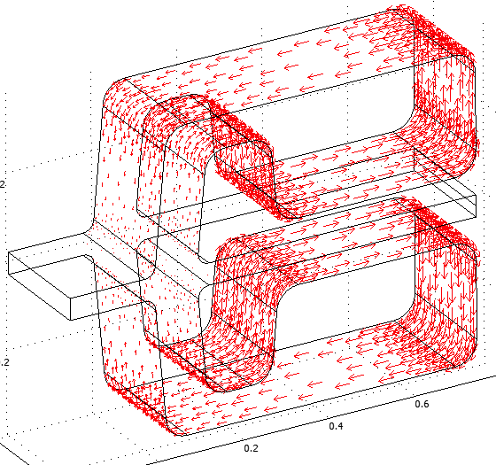
Slot-geometry ¼ wave cavity structure and distributed RF drive suppresses perturbations from wake fields
Energy coupled out
RF power is coupled to the cavity by rows of input couplers along the top/bottom lobes.
RF power is coupled from the cavity to the synchronous bunches traversing the slot gap.
The cavity serves as a linear transformer.
Its geometry accommodates transverse mode suppression
Energy coupled in

Slide 14
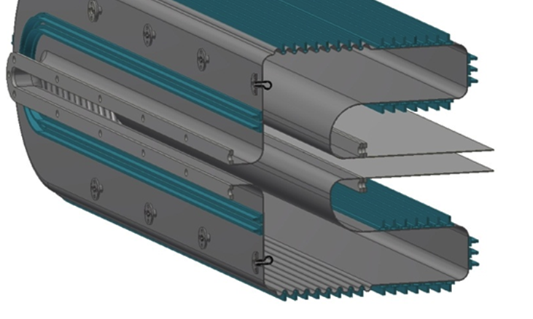
Linear coupler array to match drive to beam loading, convolutes to suppress multipacting
Each coupler driven by solid state amplifier
Distributed drive matches to distributed beam loading for stability under high beam loading.
Note: this requires that all orbits are made very close to isochronicity…

Slide 15
Outline
Motivation
  Proton driver for Accelerator-Driven Subcritical Fission
  What limits beam current in cyclotrons
Superconducting RF Cavity Fully separate all orbits
Beam Transport Channel
  Control betatron tunes throughout acceleration
  Magnetic design
  Winding prototype
Sector Dipoles
  Flux-coupled stack
  Fringe field reduction
Beam Dynamics
Future Work

Slide 16
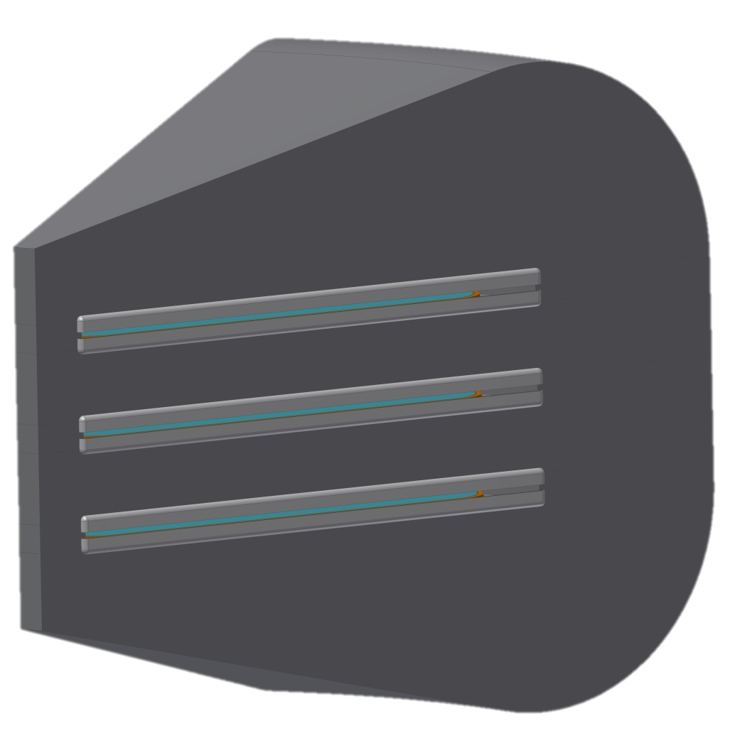
Sector dipoles - Flux-Coupled Stack
Levitated-pole design originated at Riken
Common warm-iron flux return
Each gap formed by a pair of cold-iron flux plates
Multiple SFCs in single footprint
~1 T dipole field, isochronous B(r)
Geometric wedges (optimum for rf)
Beam Planes

Slide 17
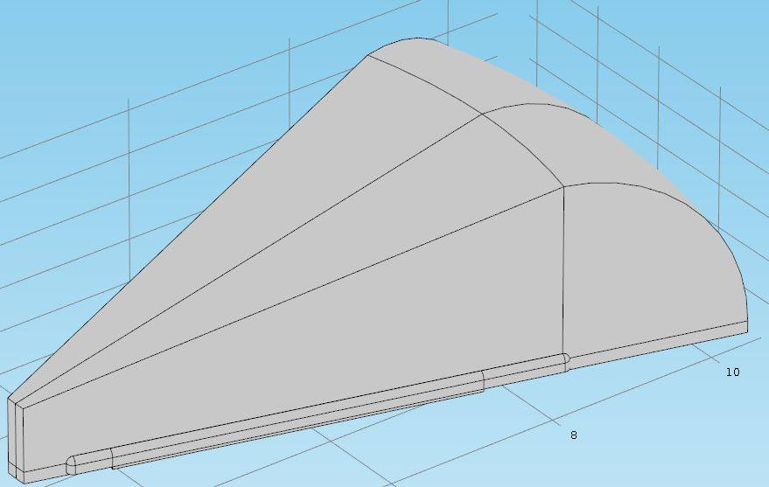
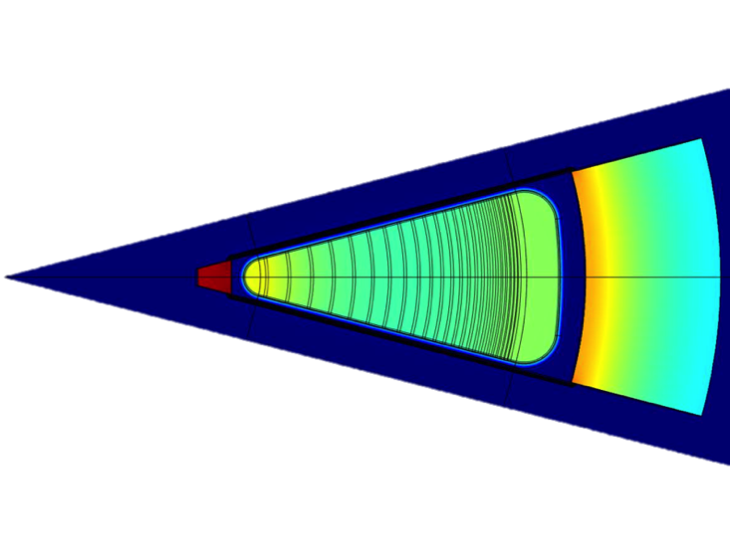

Sector Dipole Modeling
Top half of single stack cyclotron for modeling
1.8
1.6
1.4
1.2
1
0.8
0.6
0.4
0.2
Mid-plane magnetic flux density (T)

Slide 18
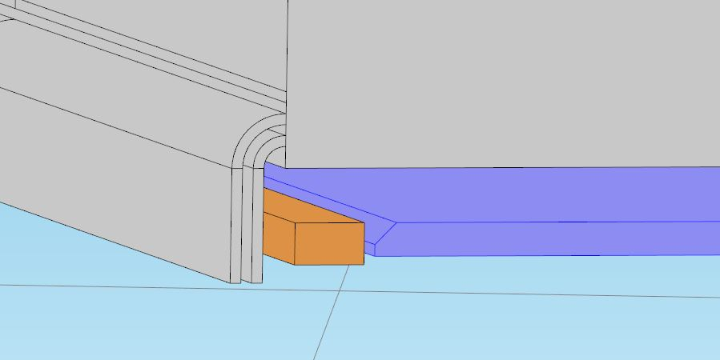
Fringe Field Reduction
Superconducting cavities require the magnetic flux density to be less than 40 mT 10 cm from the warm iron flux return.
Warm-iron flux return
Fringe field suppression
Cold iron pole piece
μT mT
MgB₂ main windings
Levitated pole method first pioneered at Riken

Slide 19
Outline
Motivation
  Proton driver for Accelerator-Driven Subcritical Fission
  What limits beam current in cyclotrons
Superconducting RF Cavity Fully separate all orbits
Beam Transport Channel
  Control betatron tunes throughout acceleration
  Magnetic design
  Winding prototype
Sector Dipoles
  Flux-coupled stack
  Fringe field reduction
Beam Dynamics
Future Work

Slide 20
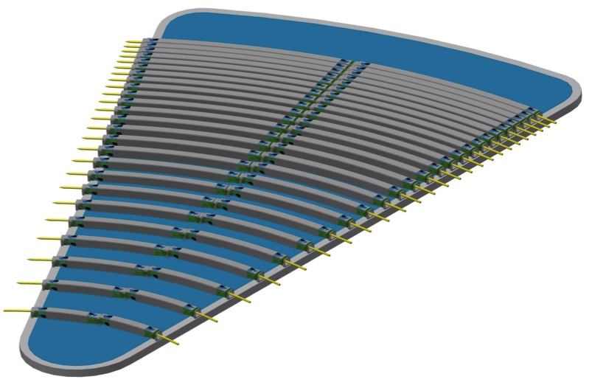
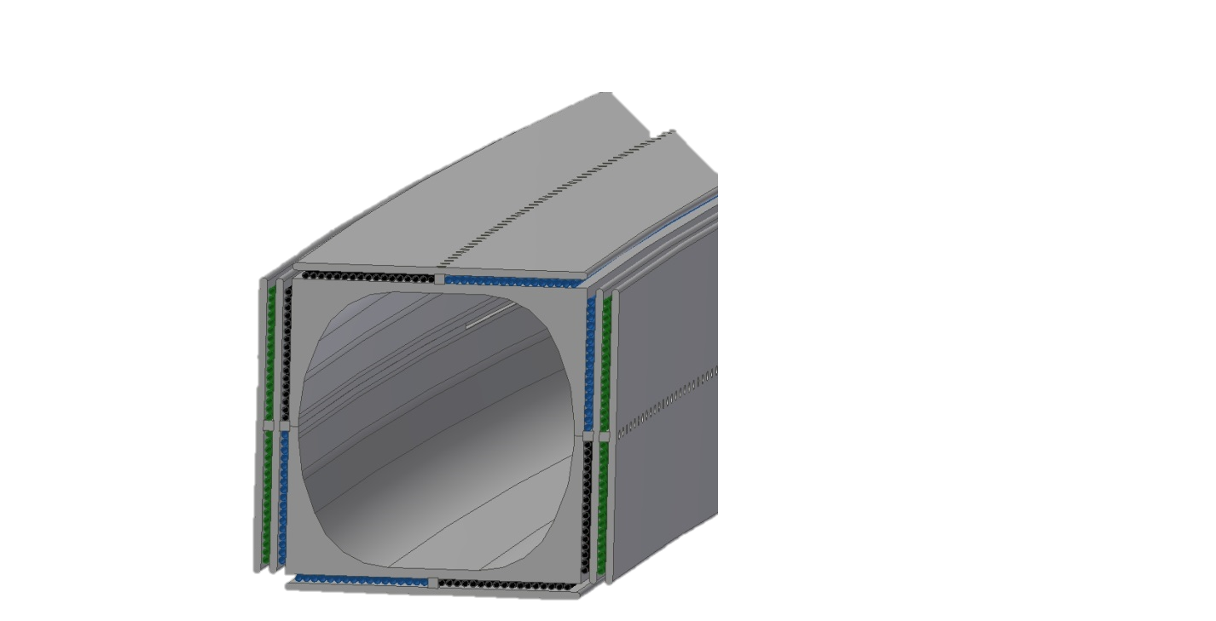
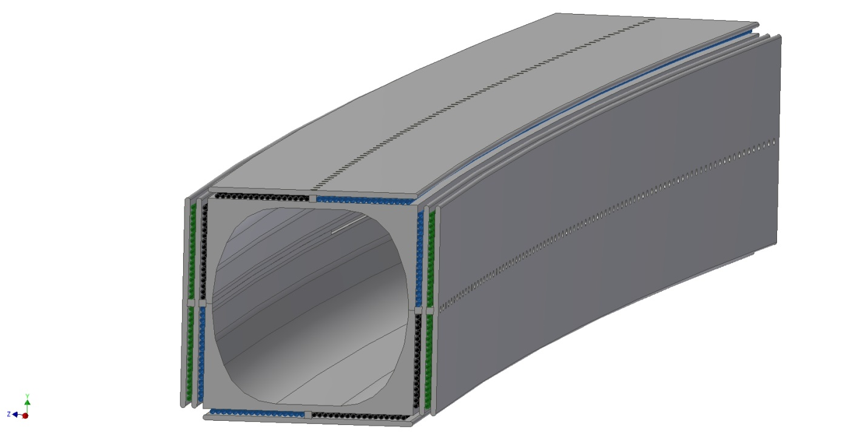
F-D doublet on each orbit, each sector
D
F
5.6cm
BTC dimension set by beam separation at extraction
>80% of horizontal aperture is useful for orbits.

Slide 21
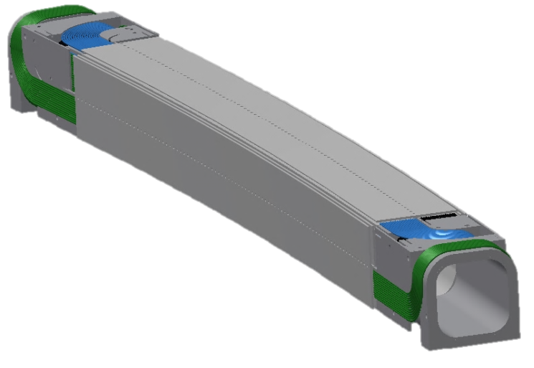
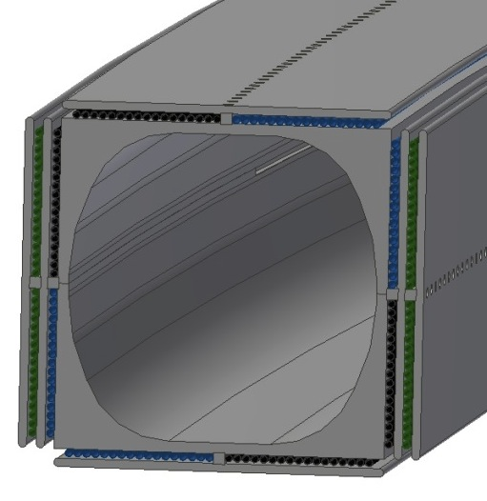
Beam Transport Channel (BTC)
Dipole Windings
Up to 20 mT
Act as corrector for isochronicity,
Septum for injection/extraction
Quadrupole Windings
Up to 6 T/m
Panofsky style
Alternating-gradient focusing
Powered in 6 families to provide total tune control

Slide 22
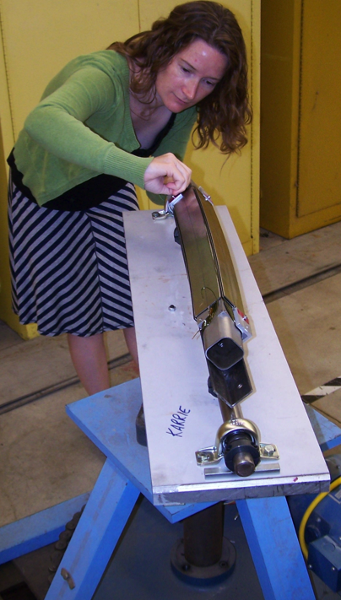
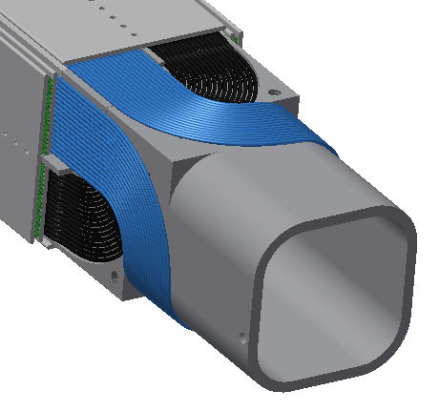
All BTC windings use MgB₂
Operate with 15-20 K refrigeration cycle
10 x less AC power to refrigerate,
50 x more heat capacity compared to NbTi @ 4.2 K

Slide 23
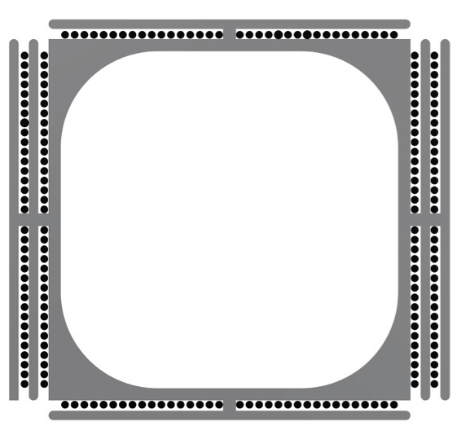
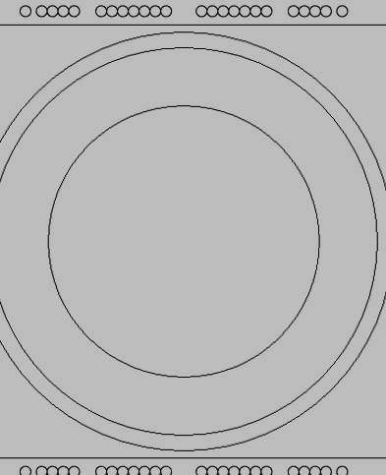
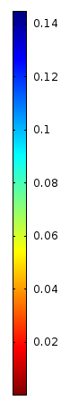
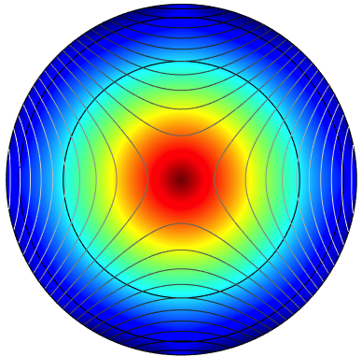
2D Field Modeling
Cold iron pole piece
T
Wire spacing adjusted to kill multipoles
Current density required for 6T/m ~ 235 A
Notes:
Using dimensions set by orbit spacing need superconductor, image with external dipole suppressed.

Slide 24
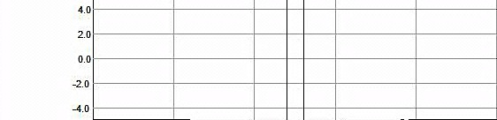
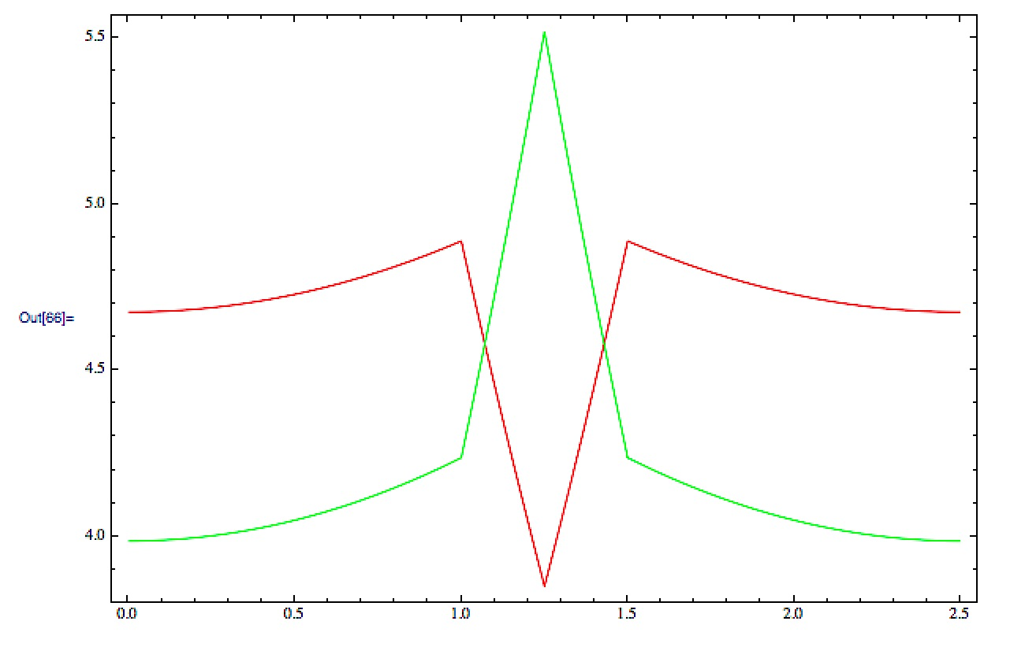
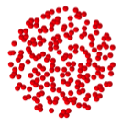
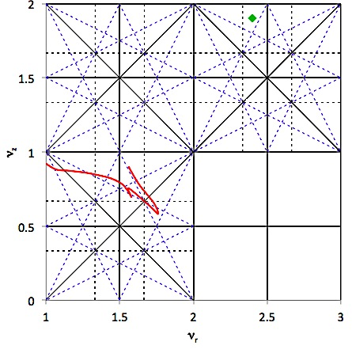
F-D quads control betatron motion
Uniform gradient in each channel: excellent linear dynamics.
5.5
5.0
4.5
4.0
0.0 0.5 1.0 1.5 2.0 2.5
We can lock ν_{x}, ν_{y} to any desired operating point.
BTC quads are tuned in 2 x 5 families.
Sextupole correctors at exit of each BTC are tuned in 2 x 6 families.
First 2 turns each have dedicated families so that they can be tuned first for rational commissioning.

Slide 25
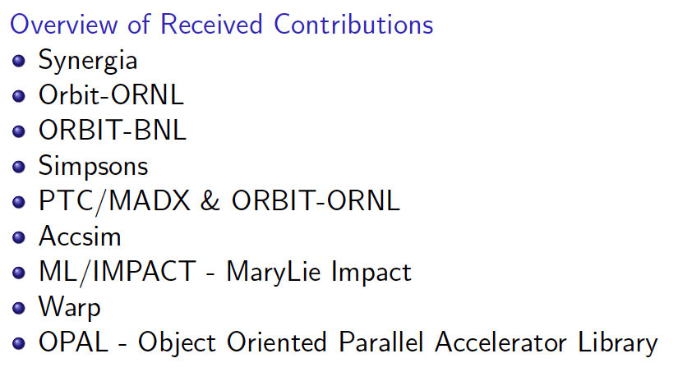
We have developed a simulation platform that takes high-current bunches through the spiral orbit, treating it as a spiral transfer line.
Accounts for details of 6-D dynamics:
resonance dynamics,
synchro-betatron couplings,
space charge,
wake fields
beam loading
Later
No access
No access
Elegant
Later
Hyper_TAMU, MPI_TAMU

Slide 26
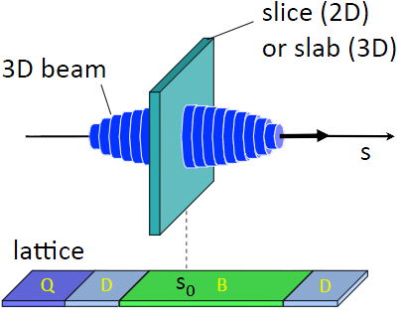
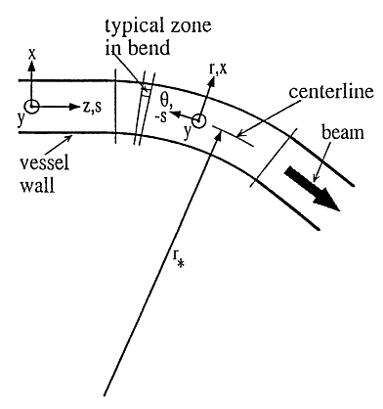
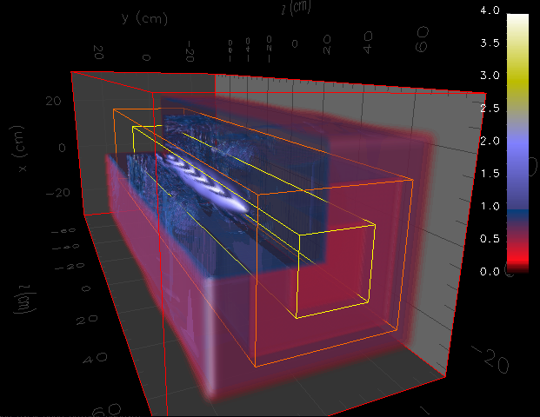
Coordinates, Mesh, Global coordinates,
Beam assumptions…

Slide 27
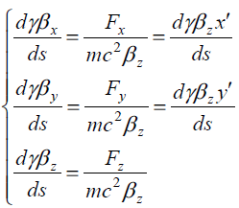
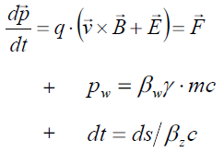
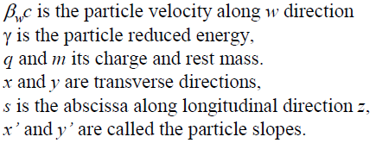

Equations of motion are nonlinear, coupled, damped:
The code enables us to make a self-consistent solution for B(r); RF ΔE(r) and φ(r), BTC gradients, BTC trim dipoles, sextupoles to simultaneously provide isochronicity, constant tunes, stable phase advances.
It then tracks, generates Poincare plots, etc for desired bunch properties.

Slide 28
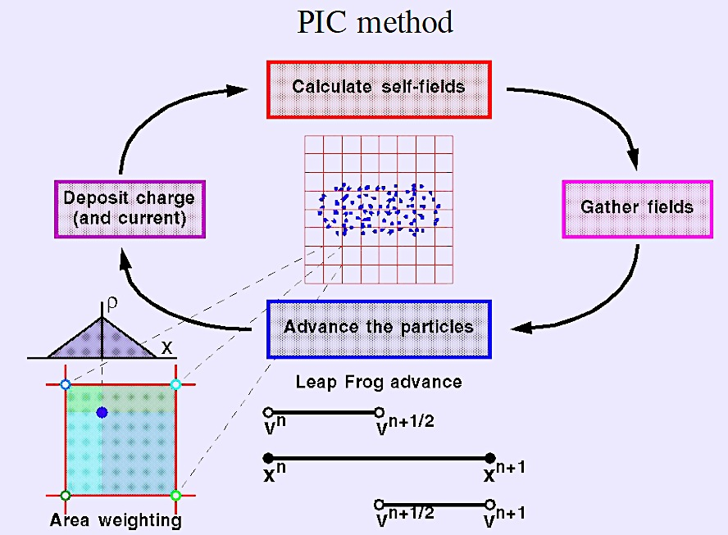

Slide 29
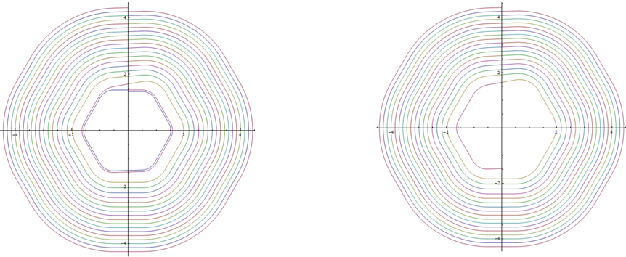
Dipole Corrector
The BTC dipole correctors are used to maintain isochronicity and locally manage beam spacing at injection, extraction.
Example of ability to adjust orbits to optimize design (from a 6 sector 100 MeV SFC design):
Design orbits working in from extraction:
First try gave problematic orbits @ injection
Then adjust orbit pattern using dipole correctors – ideal accommodation for injection

Slide 30
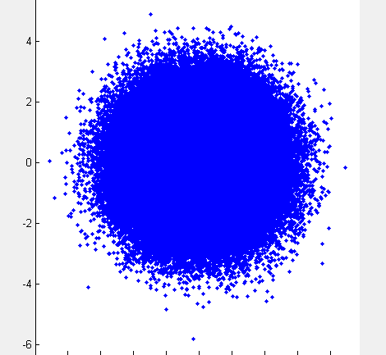
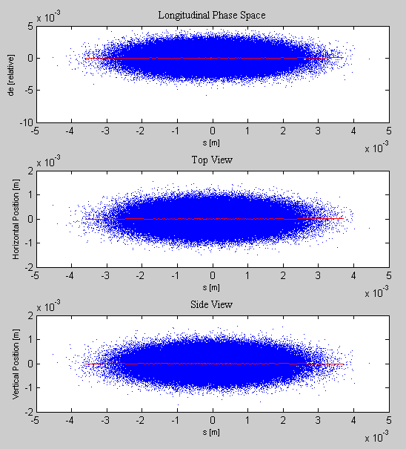
We are now modeling 6-D transport through the SFC including effects of x/y coupling, synchrobetatron, and space charge
300k particle simulation

Slide 31
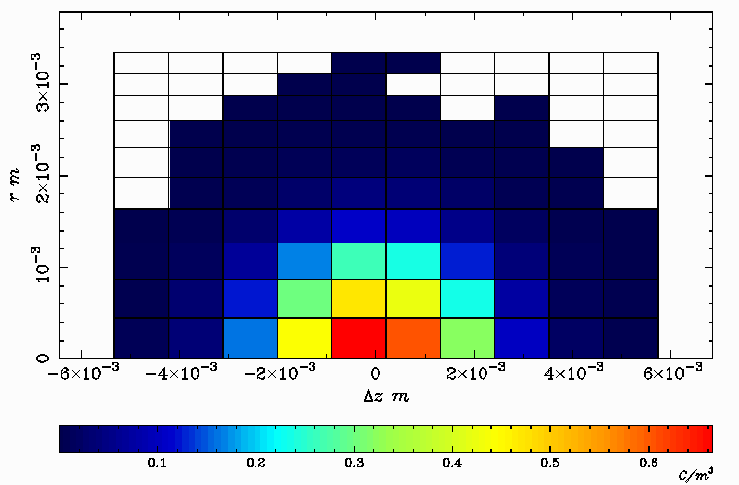
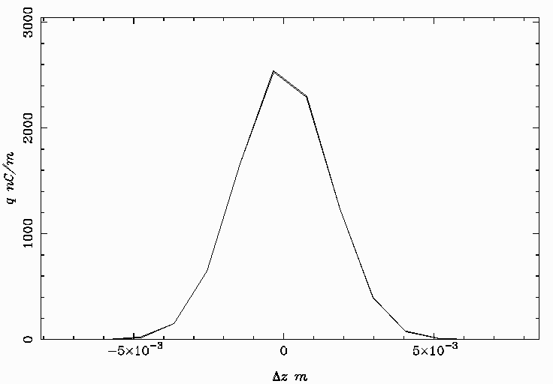
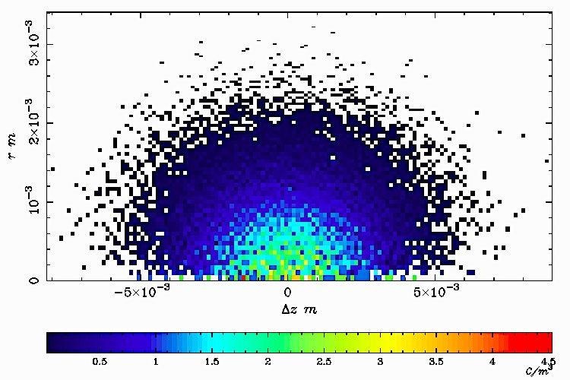
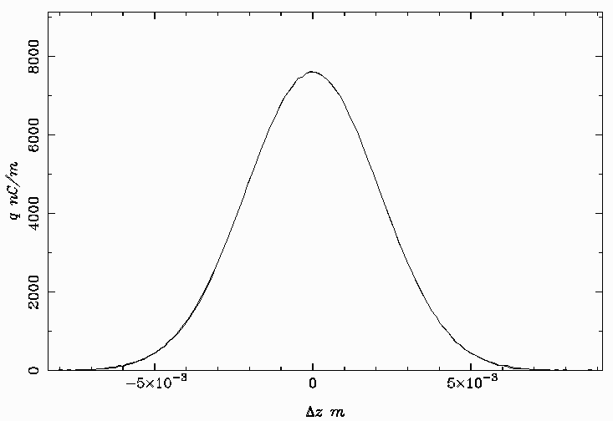
Charge Density for 10 mA beam
2K particles
Longitudinal charge distribution
20K particles
20k particle

Slide 32


Matched optics from injection to extraction. Left pictures shows how a bunch transfers from one sector
To another.
radial E from space charge inside bunch
head tail
I σ
10 mA beam, ± 5º total phase width
Plots of slice energy spread and β mismatch after first turn, sensitive to bunch length – no hourglass from synchrobetatron

Slide 33


Effect of ±.3 MeV energy mismatch on a bunch injected at 9 MeV
bunch is clumping after half-turn (after 2 cavities)

Slide 34


Longitudinal line charges along a bunch
- 10 mA beam, injected at 9 MeV.
Radial E from space charge
Distortion in distribution comes from the space charge
After first cavity just before extraction

Slide 35


Accelerating bunch at injection, extraction
Axial E from space charge
9 MeV
100 MeV

Slide 36


Longitudinal phase space with 10 mA
9 MeV injection 100 MeV extraction
±5º phase width ±6º phase width
Energy width increases ~30%. Sextupole correction at exit from each BTC
(2 x 6 families)

Slide 37



Transverse phase space of 10 mA bunch through acceleration:
Vertical Emittance
First at injection:
x/y profile
Horizontal Emittance

Slide 38


Now look at effects of synchrobetatron and space charge with 10 mA at extraction:
Move tunes near integer fraction resonances to observe growth of islands
After two turns … bunch is lost by 20 MeV
1/3 order integer effect
1/5 order integer effect
1/5-order islands stay clumped, 1/3-order islands are being driven. Likely driving term is edge fields of sectors (6-fold sector geometry). We are evaluating use of sextupoles at sector edges to suppress growth.

Slide 39


Synchrobetatron/space charge in longitudinal phase space:
Tunes again moved to approach resonances, but retaining transmission through lattice
Injection extraction
Phase width grows x5 at extraction

Slide 40
Poincare Plots of 5 σ contours
An example favorable operating point: (ν_{x}, νy) = (3.196, 3.241)
3.5 mA
beam
Injection 40 MeV Extraction
Now change the tune to excite a 7th order resonance

Slide 41
Conclusions
The strong-focusing cyclotron is a new member of the FFAG family.
It is optimized to accelerate the highest possible CW beam current with low losses and high energy efficiency.
We have validated the capability of the design to accelerate 10 mA with excellent transport.
Control of betatron tunes and ability to naturally match input RF to beam loading across the entire width of the spiral orbit are key strategic elements.
Phase space dynamics for optimized orbit should be simple to diagnose – no COD, no E-φ serpentine, no resonances
Anyone who can tune a synchrotron or linac for low loss, high current could tune a SFC.
So far as we can determine from these early studies, it is not yet clear what will be the ultimate limits to beam current.

Slide 42
Future plans
To Do:
  SRF cavity
  Wake fields, beam loading, optimize input coupler array
  Build/test prototype cavities
  Beam Transport Channel:
  Finalize copper test wind
  Quench modeling and protection
  MgB₂ winding
  Sector Magnet
  Refine pole piece and shielding fins - FEA models and prototypes
  Beam dynamics
  Model beam loading, wake fields, patterns of input couples in SRF cavities

Slide 43

Come collaborate with us!
Thank you!

